Slide 1
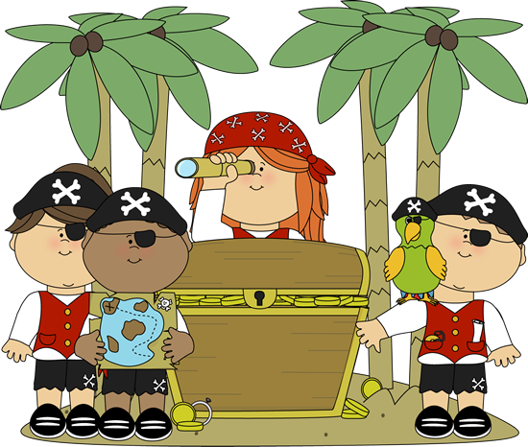
Where is the treasure?
Year R
Term 5
The characteristics of effective learning- playing and exploring, active learning and creating and thinking critically, underpin learning and development across all areas and support the child to remain an effective and motivated learner.
Personal Social and Emotional
Being My Best
Feel resilient and confident in their learning.
Name and discuss different types of feelings and emotions.
Learn and use strategies or skills in approaching challenges.
Understand that they can make healthy choices.
Name and recognise how healthy choices can keep us well.
Communication and Language
Learn new vocabulary
Use new vocabulary through the day.
Engage in non-fiction books.
Learn rhymes, poems and songs.
Listen to and talk about selected non-fiction to develop a deep familiarity with new knowledge and vocabulary.
Participate in small group, class and one-to-one discussions, offering their own ideas, using recently introduced vocabulary.
Offer explanations for why things might happen, making use of recently introduced vocabulary from stories, non-fiction, rhymes and poems when appropriate.
Physical Development
They can use one handed tools such as scissors.
They use a comfortable grip with good control when holding pens and pencils.
They demonstrate strength, balance and coordination when playing.
They can run, jump, dance, hop, skip and climb.
Key Vocabulary
Compass | A tool for finding direction
Cannon | A large gun that fires heavy metal shells
Skull and cross bones | A warning of death or danger
Cutlass | A short curved sword
Buccaneer | Another word for ‘pirate’
Literacy
Writing; They use their phonic knowledge to write words. They can write some harder to read and spell words. They write phrases which can be read by themselves and others.
Reading; They read words consistent with their phonic knowledge by sound blending. They demonstrate an understanding about what they have read. They can describe the main events in a simple story.
Phonics; Apply phonics skills in reading and writing activities. Continue to use and apply harder to read and spell words.
Maths
Count beyond ten.
Automatically recall number bonds for numbers 0–5 and some to 10.
Select, rotate and manipulate shapes to develop spatial reasoning skills.
Compose and decompose shapes so that children recognise a shape can have other shapes within it, just as numbers can
Key Events
World Earth Day
Pirate Day
Community picnic
Class Assemblies
Stories/ Songs/ Poems
The Night Pirates
Pirates love underpants
My Granny is a pirate
Pirates don’t go to school
Pirate Pete
Sea shanties
Yo ho yo ho a pirates life for me
When I was one
The life of a pirate ain’t easy
Understanding of the world
Explore the natural world around them, making observations and drawing pictures of animals and plants.
Know some similarities and differences between the natural world around them and contrasting environments, drawing on their experiences and what has been read in class.
Understand some important processes and changes in the natural world around them, including the seasons and changing states of matter.
Expressive Arts and Design
They experiment with colour, design, texture, form and function.
They use what they have learnt about media and materials in original ways.
They represent their own ideas through design technology, arts, music, dance, role play and stories.
They can develop their own creative ideas.
Although these are suggested activities for this theme, we are ultimately led by the interests and needs of the children.

